Slide 1


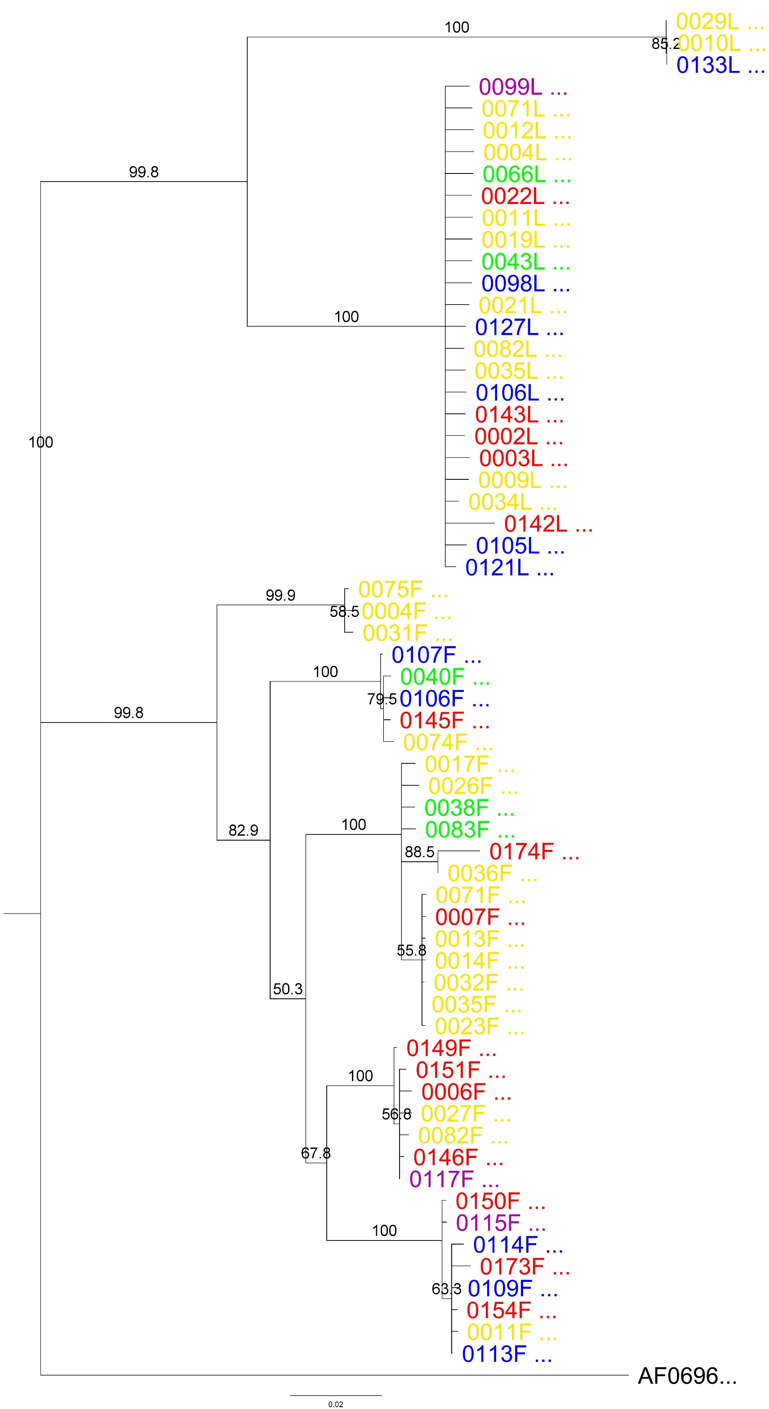
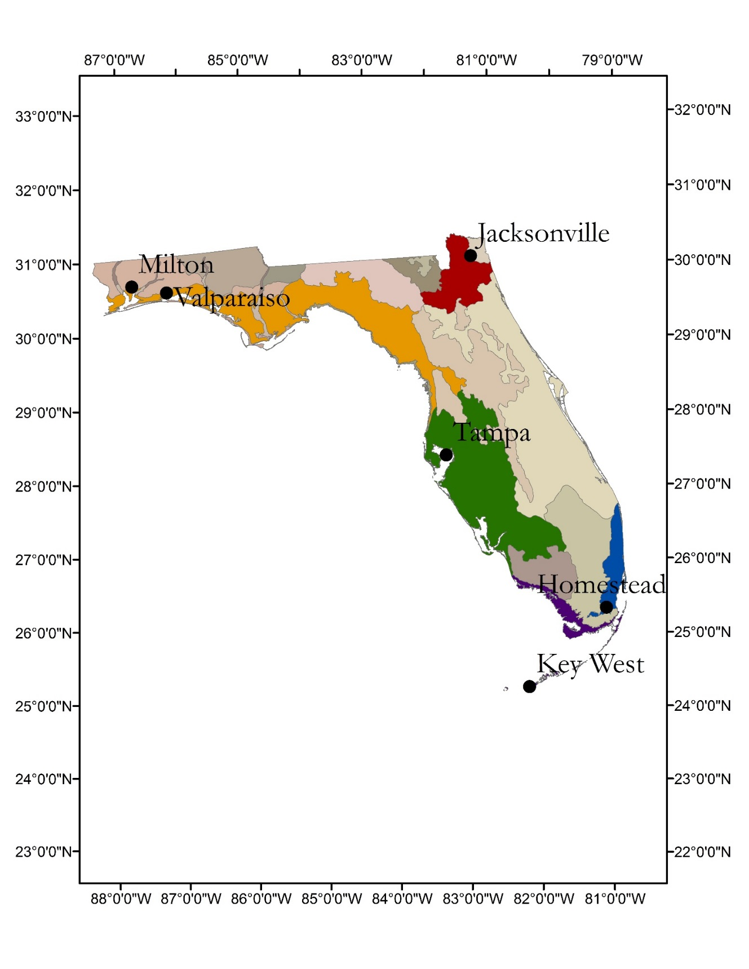
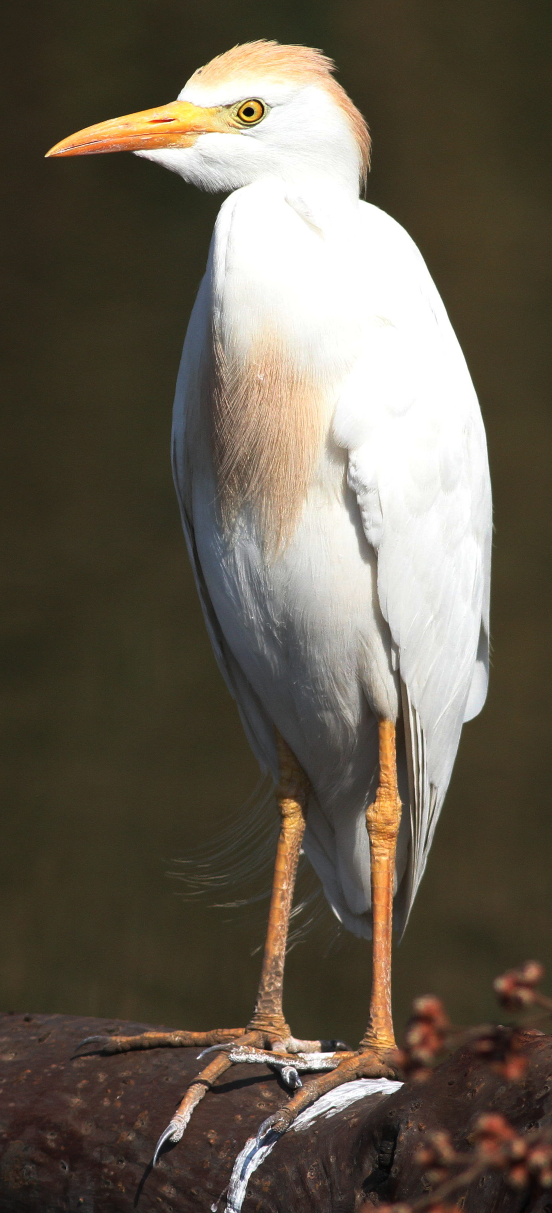
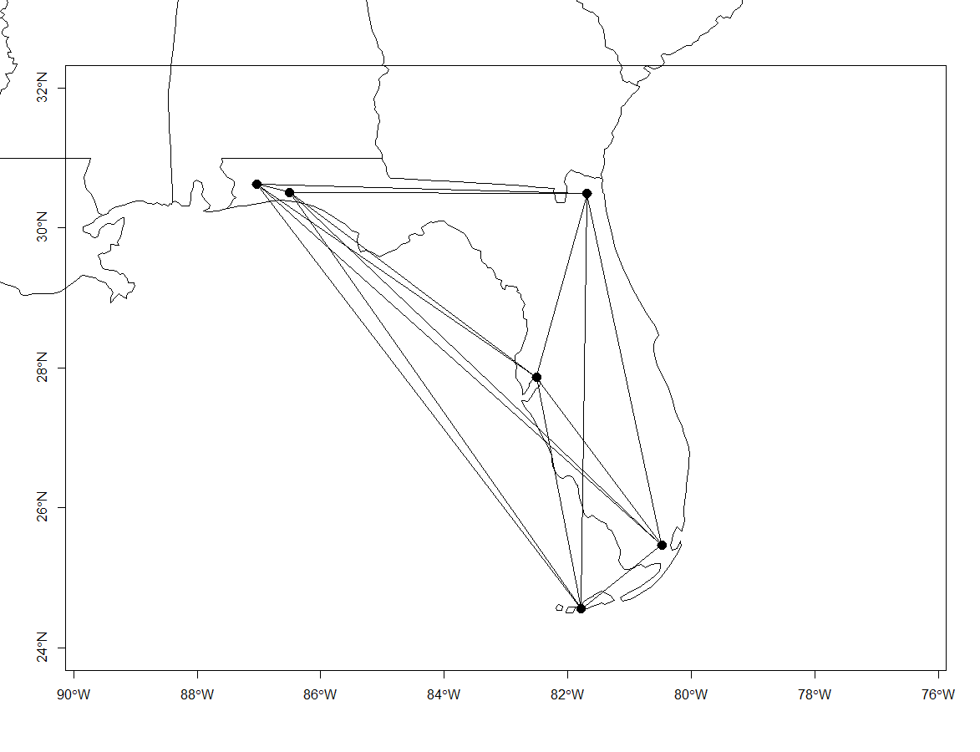
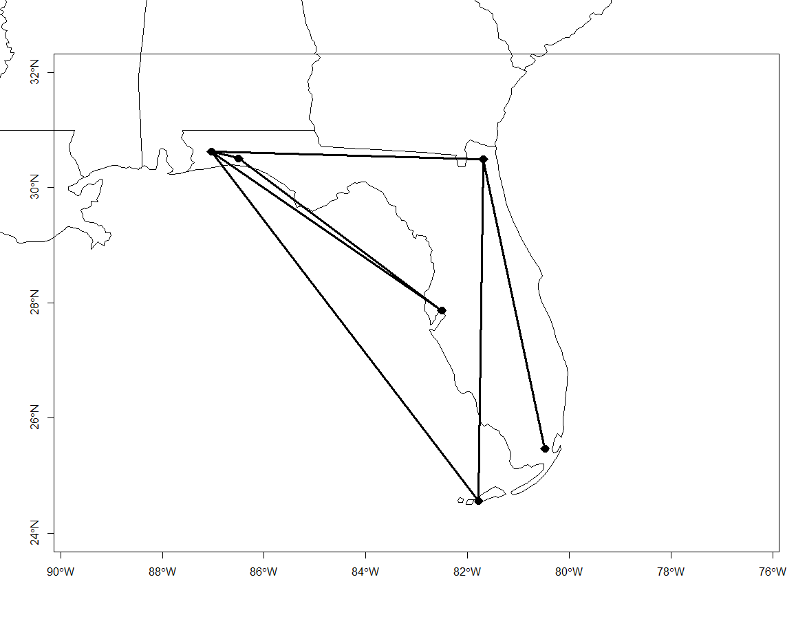
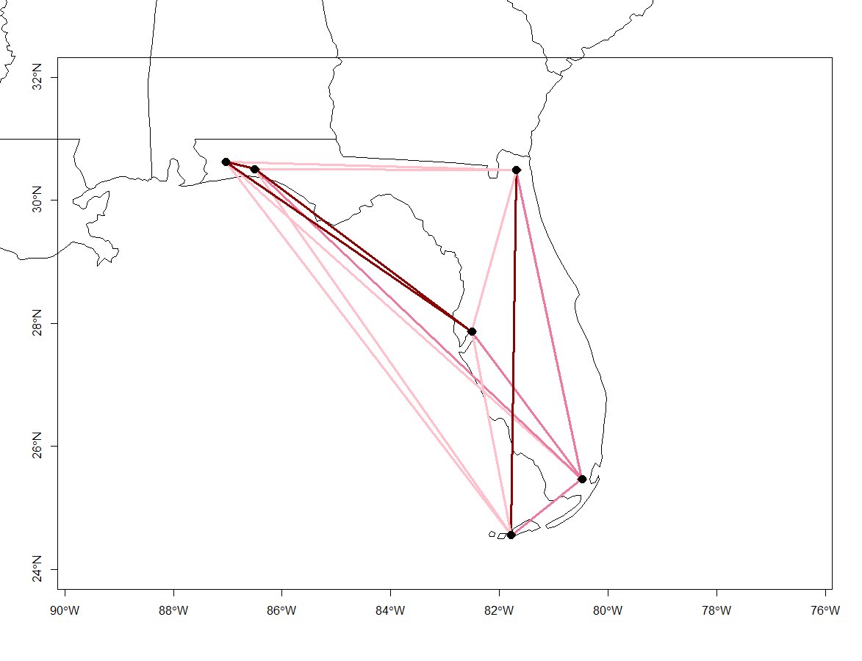
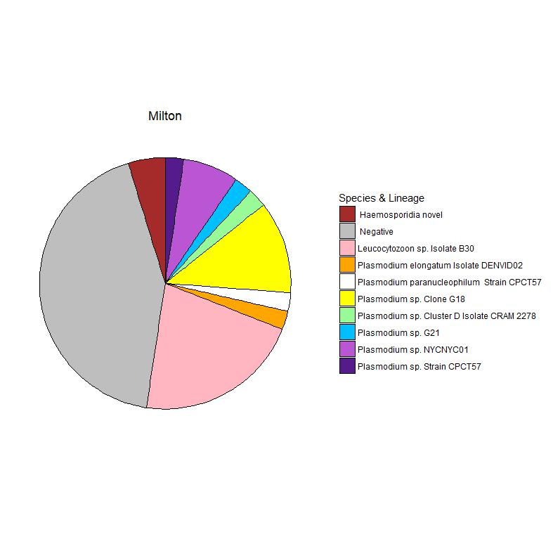
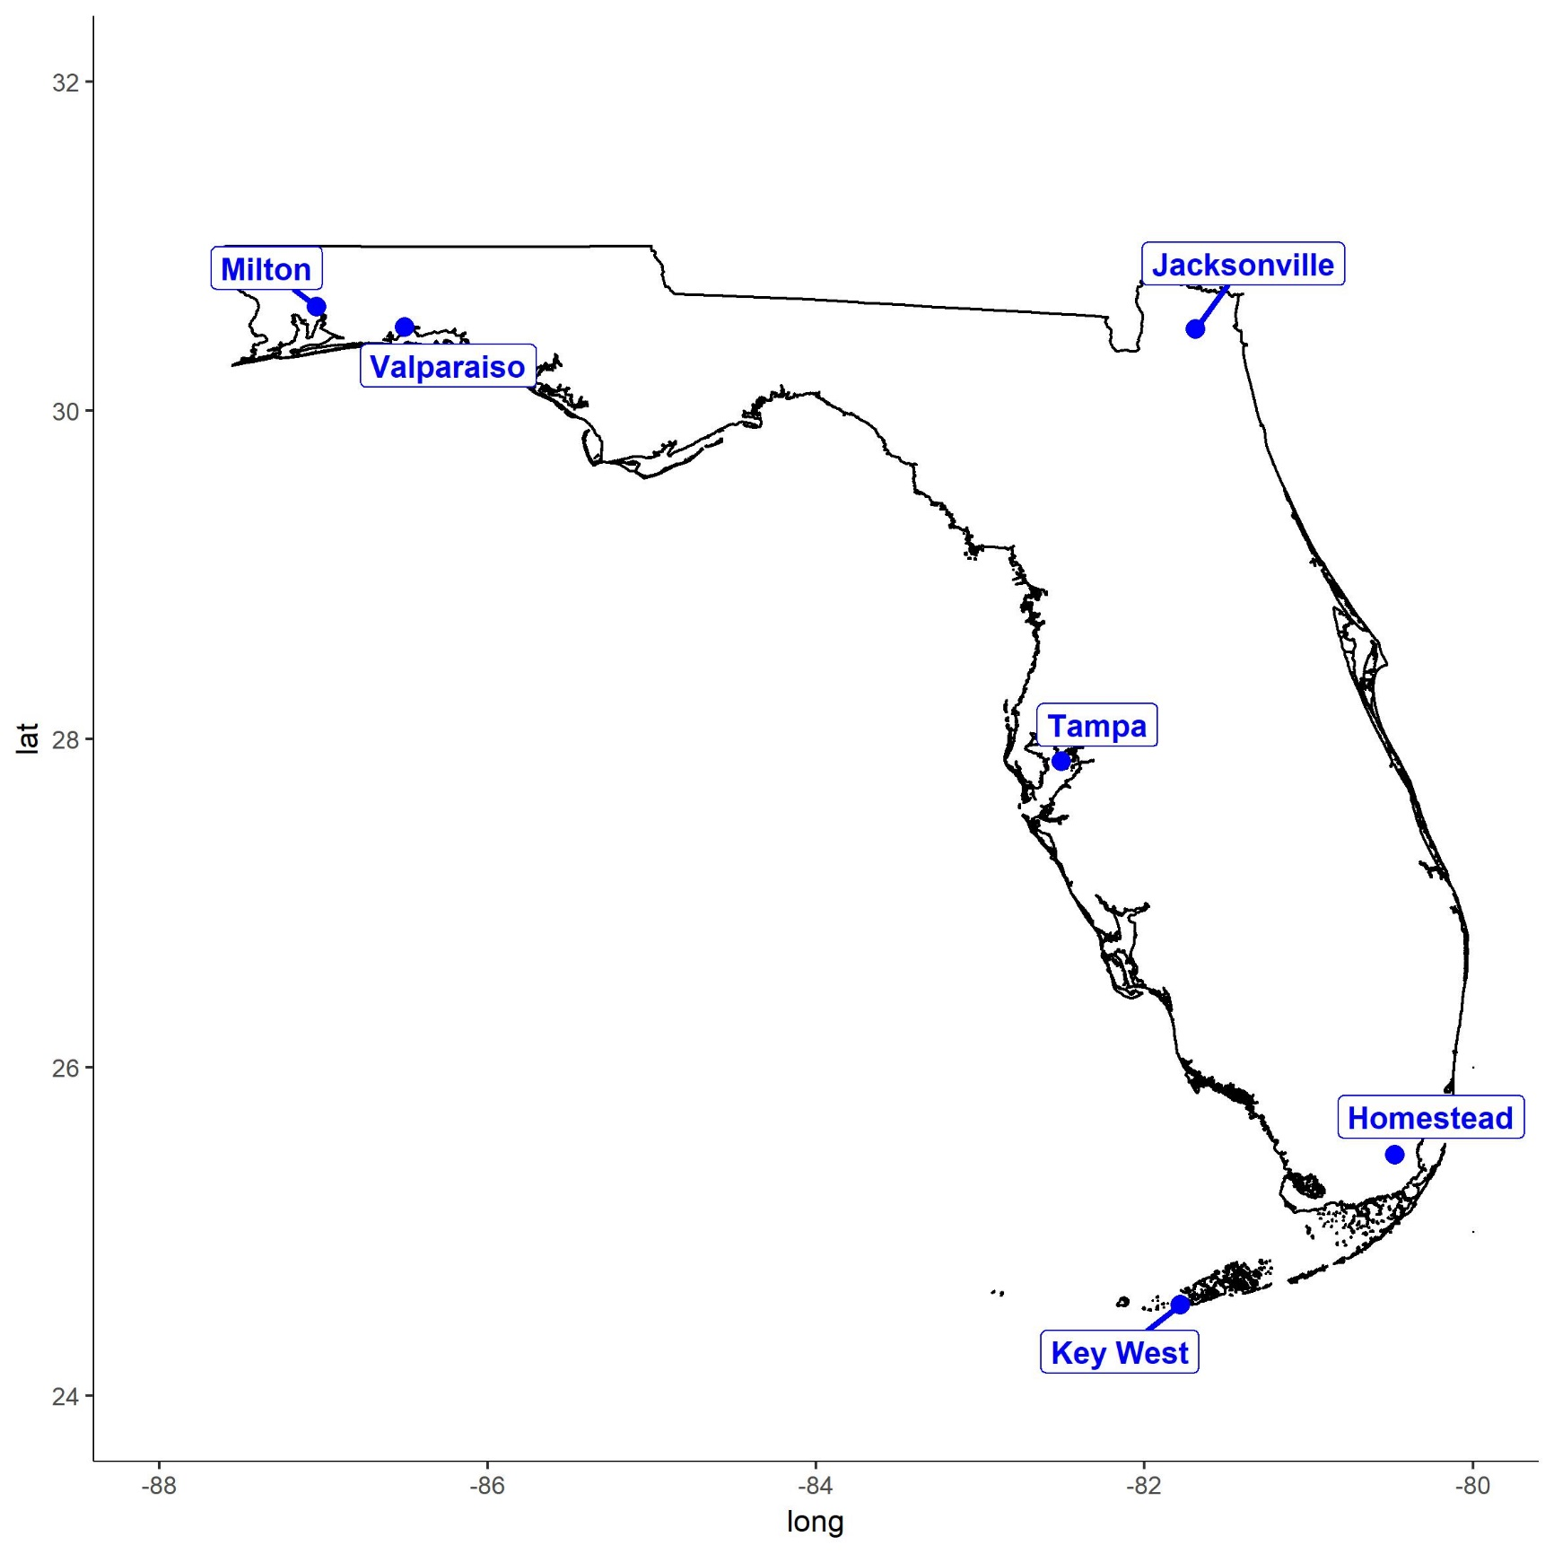
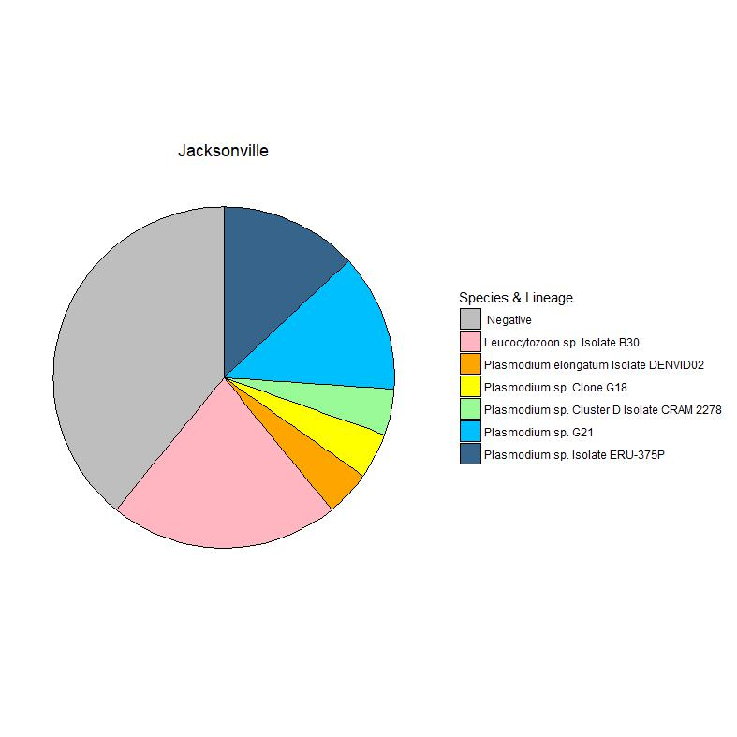
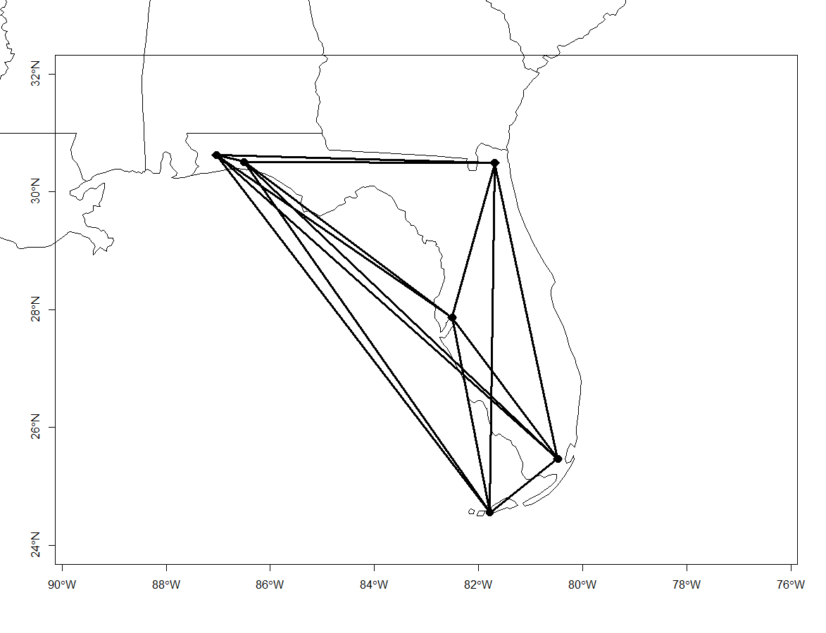
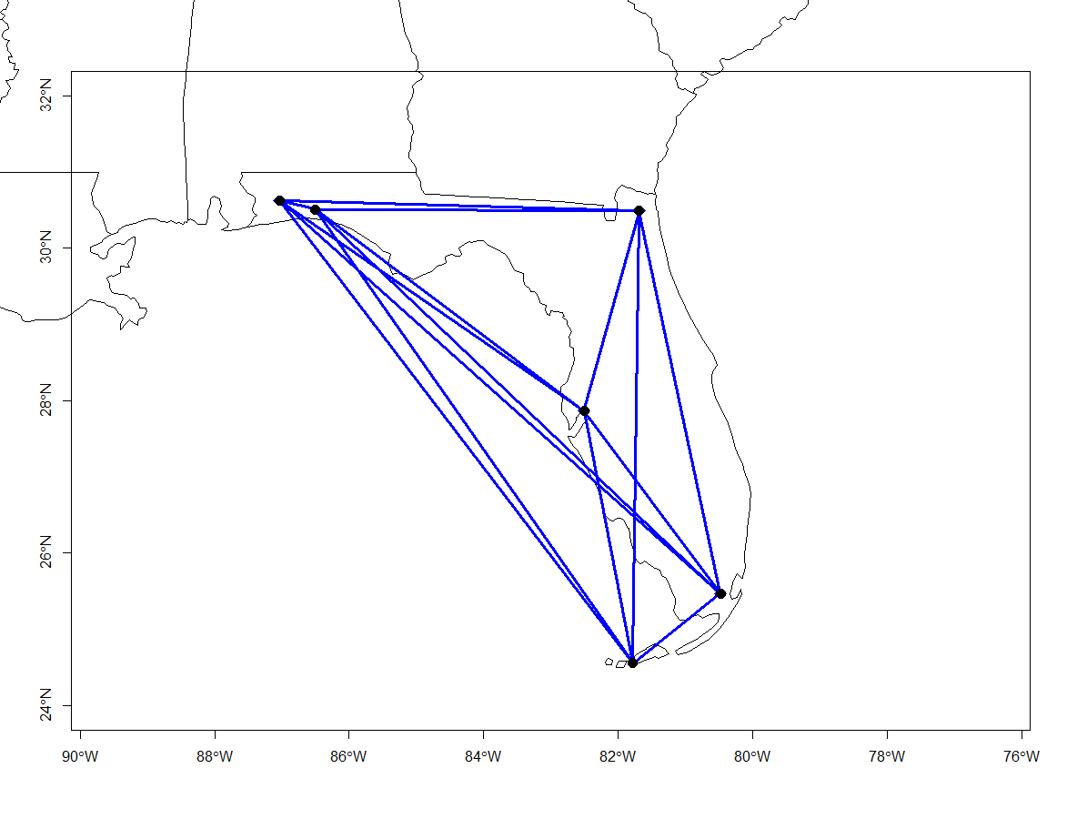
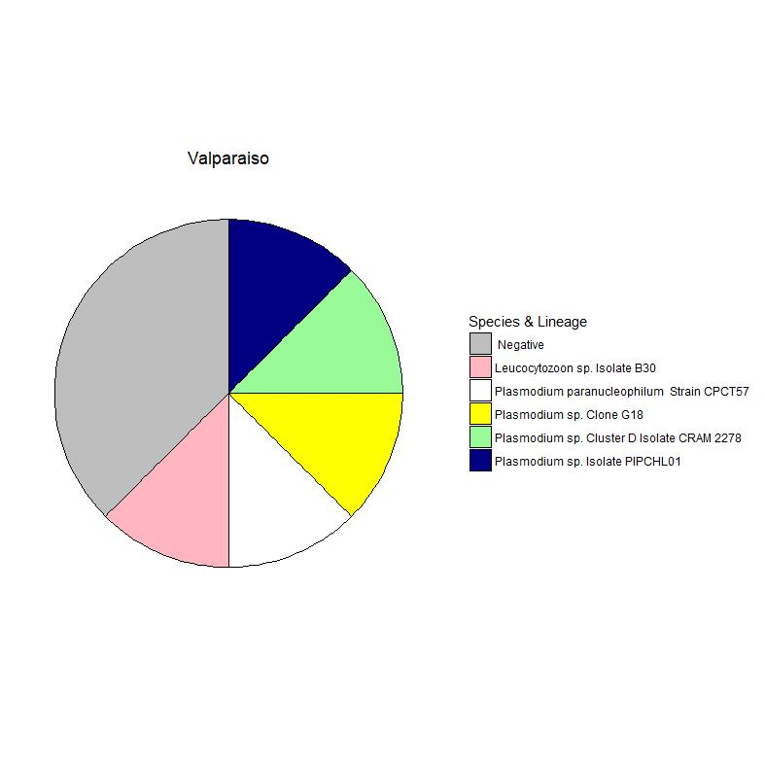
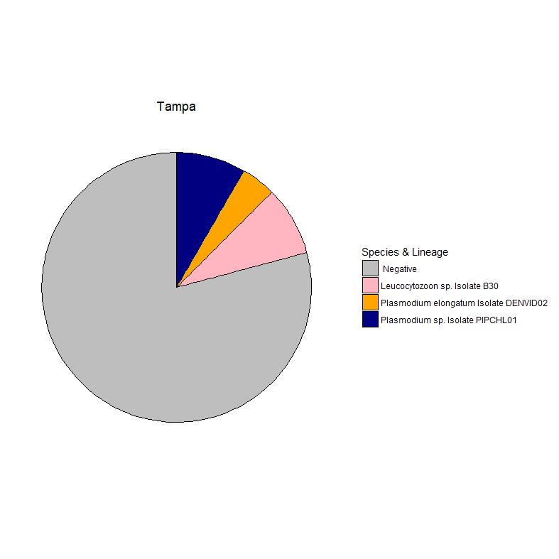
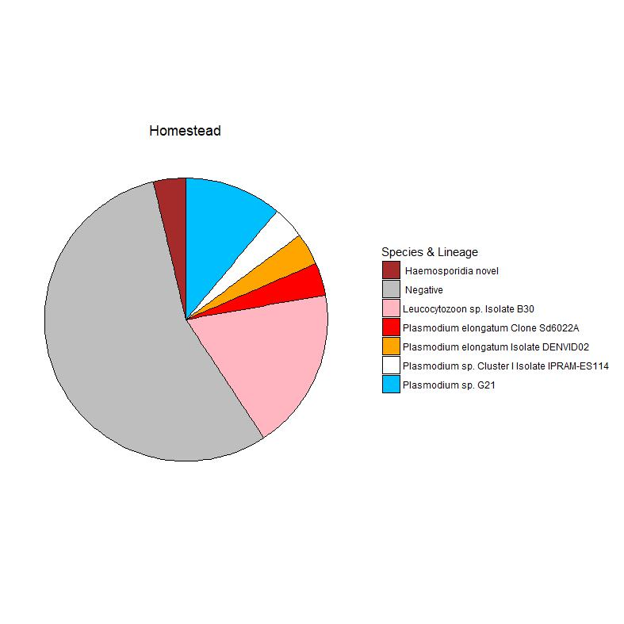
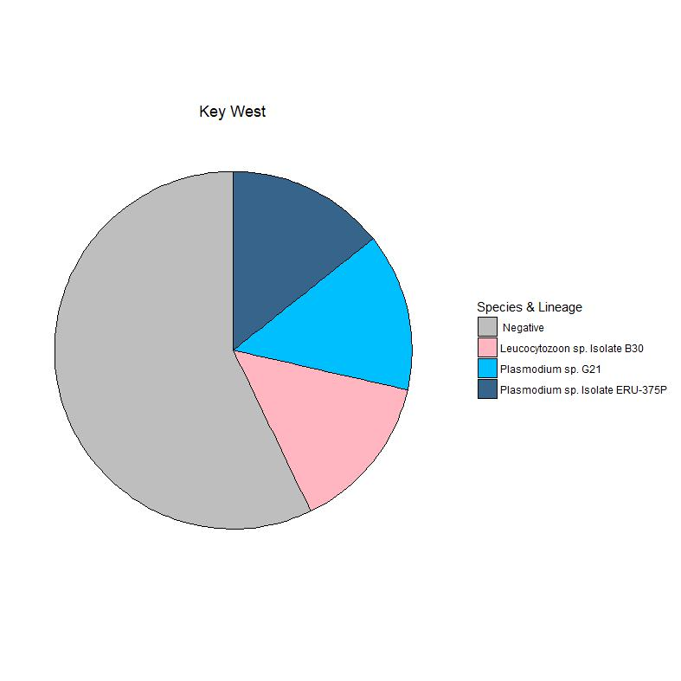
Spatial variation and biogeographical patterns of Haemosporidia in Florida Cattle Egret (Bubulcus ibis)
Phylogeny
Shannon P. Moore¹, Kim Ledger¹, Emily Dinh²
¹ Department of Wildlife Ecology and Conservation, University of Florida, 32611; ²Department of Geography, University of Florida, 32611
Background
Objectives
Emergence of vector-borne disease has been linked to global climate change
Avian Haemosporidia- widely distributed blood parasites transmitted by arthropod vectors and their avian hosts
Cattle Egrets- rapidly expanding avian species, little is known about the potential for pathogen transport
Haemosporidia may be a good model for investigating the role of climate change in arbovirus emergence
Display prevalence of Avian Marlaria strains in Cattle Egret across Florida
Measure connectivity of Avian Malaria in Cattle Egret across Florida
Vectors
Methods
Colors on phylogenetic tree correspond with Florida ecoregions. Labeled locations are sample sites.
Euthanized Cattle Egret were collected during routine airstrike prevention at airports
Muscle and spleen were collected during necropsy of Cattle Egret
DNA was extracted from spleen and screened for regions of the cytochrome b gene of the Haemosporidia mitochondrial DNA
Positive samples were determined with gel electrophoresis and then Sanger sequenced
Prevalence
Connectivity
Probability Matrix Map
Binary Matrix Map
Weighted Matrix Map
Plasmodium
Leucocytozoon
Conclusions
Compare prevalence, phylogeny, and diversity of haemosporidia in cattle egret to other avian species
Increase sample size and range
Characterize distinct sequences (Clade Leuc 2)

